Slide 1
INSTANCE SEGMENTATION OF NEWSPAPER ELEMENTS IN JPEG DOMAIN
Guide - Dr.Mohammed Javed
Group Members :
Aman Raj Patwa (IIT2018038)
Rahul Kumar Yadav (IIT2018071)
Hrutvik Nagrale (IIT2018088)
Ravi Kumar (IIT2018094)
Sagar Kumar (IIT2018154)

Slide 2
INTRODUCTION
Newspaper archives contain an ocean of information which is being made digitally available. However, mass digitization of newspapers comes with its own set of challenges.
Almost any information printed on the newspapers can be extracted correctly, Technologies like OCR, optical character recognition, are used to extract text out of the newspapers.
But before we start extracting any information we need to identify which sections of the newspaper are important and which other sections should be ignored.
We need to separate articles from advertisements, page headings from main articles, graphs and charts from graphic elements, etc. What makes it more challenging is newspaper layouts, language, text styles, all of these vary from newspaper to newspaper.

Slide 3
LITERATURE SURVEY
In our knowledge, there was very less previous research on finding an instance segmentation model on newspaper articles which involved work in the JPEG domain.
The main approach for article segmentation in which low-level components of an article such as columns, titles, paragraphs and pictures were classified and then it extracted to clustered together to form an article.
The reference paper used mask R-CNN for the instance segmentation of newspaper elements in which they semantically segment newspaper pages into three main elements (articles, advertisements, and page headers) and it had done in two stages, first one is small Region Proposal Network and second stage did the feature extraction like it could able to segment non-rectangular shape and so on.

Slide 4
PROBLEM STATEMENT AND OBJECTIVE
Statement: Given a newspaper image, segment all major distinct elements (articles, headings, article images and advertisements) in the image.
Objective:
Deconstructing the information which is useful and separating out the important part from a less important part in the image is a tedious task.
Here, we attempt to segment a newspaper image into major distinct categories - articles, headings, article images and advertisements.
Since we hope to build a fully Convolutional Network, this task of segmentation can span different languages and irregular shape, size and orientation, irrespective of the layout of the newspaper.
Improve already available models on Newspaper segmentation.

Slide 5
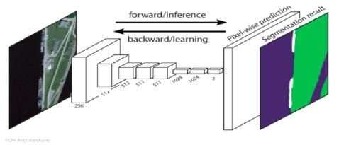
Basic Introduction to Fully Convolutional Network
The Fully Convolutional Network (FCN) learns a mapping from pixels to pixels, without extracting the region proposals. The FCN network pipeline is an extension of the classical CNN.
The main idea is to make the classical CNN take as input arbitrary-sized images. The restriction of CNNs to accept and produce labels only for specific sized inputs comes from the fully-connected layers which are fixed.
Contrary to them, FCNs only have convolutional and pooling layers which give them the ability to make predictions on arbitrary-sized inputs.
FCN Architecture
One issue in this specific FCN is that by propagating through several alternated convolutional and pooling layers, the resolution of the output feature maps is down sampled. Therefore, the direct predictions of FCN are typically in low resolution, resulting in relatively fuzzy object boundaries.

Slide 6
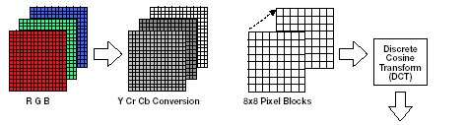
PROPOSED METHODOLOGY
Data preparation using a part of JPEG Compression algorithm:
Dataset of newspaper image will go through a series of conversions, first the RGB colour channels of the input image will be converted to YCbCr color model. Then after it will be downsampled . After this, we will use Discrete Cosine Transformation (DCT) on each of the channels.
Element-wise Segmentation on the input images:
For segmentation purposes, we will use a Fully Convolutional Network. The model will produce different masks for each distinct element (articles, page headings, article images and advertisements) in the newspaper image.The model will produce different masks for each distinct element.

Slide 7
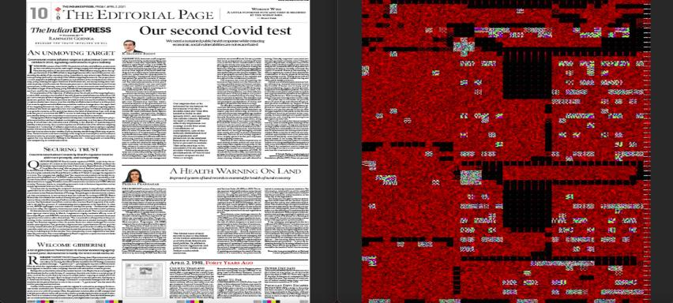
DCT Transformation
Fig 1 : Original RGB image and it’s corresponding DCT image.

Slide 8
Newspaper images segmentation Datasets
Russian Newspaper dataset :-
This dataset was collected for training and validation of machine learning algorithm for classification regions of documents on text, picture and background areas. It contains 101 scanned images of various newspapers and magazines in Russian. Most of the images have resolution 300 dpi and size A4, about 2400x3500 pixels.There are three classes: text area, picture area, background.
Manual Dataset Preparation :-
This dataset consist of 150 Newspaper images containing original image and it's corresponding masked image in English. All image are about 1024x645 pixels. For all images ground truth pixel-based masks were manually created. The ground truth masks named like original images with postfix -m . There are five classes: Article,image, background, Heading and other useful contents(Graphs, Charts, Advertisement). Pixels on the mask with color 255, 0, 0 (rgb, red color) correspond to picture area, pixels with color 0, 0, 255 (rgb, blue color) correspond to text area, all other pixels correspond to background. Images with background of different colors are in the dataset.

Slide 9
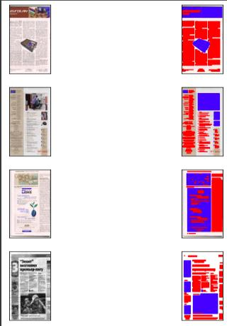
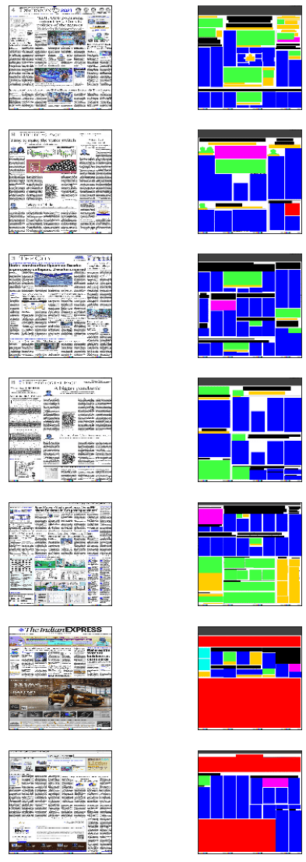
Fig 2 : Russian Dataset Examples Fig 3: Manually Masked Dataset Examples

Slide 10
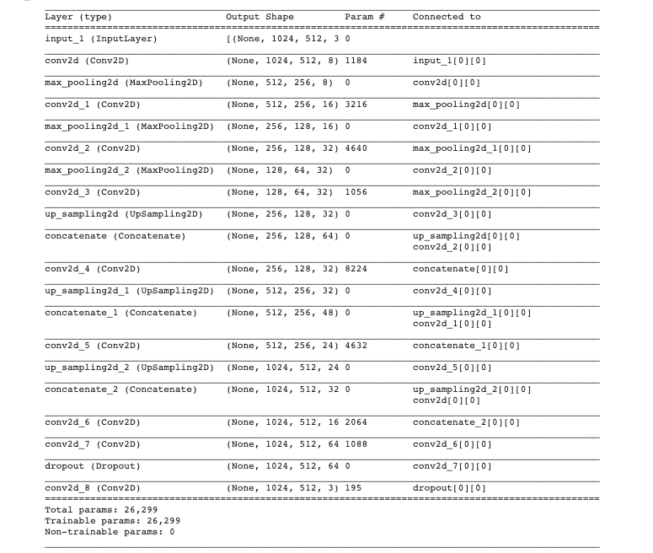
FCN Model Architecture
Fig 4: Model Summary of our Model.

Slide 11
Model summary Description
The proposed model consists of different convolutional layers which are 9- Conv2D,
3- Max_pooling2D, 3- Up_sampling2D, 3- Concatenate and 1- Dropout.
Kernel : It is a convolution matrix or masks which can be used for blurring, sharpening, embossing, edge detection, and more by doing a convolution between a kernel and an image.
Conv2D: This layer creates a convolution kernel that is convolved with the layer input to produce a tensor of outputs.
Max_pooling2D: Downsamples the input along its spatial dimensions (height and width) by taking the maximum value over an input window (of size defined by pool size ) for each channel of the input.
Upsampling: It is just opposite of pooling. It works by repeating the rows and columns of the input.
Concatenate : It takes as input a list of tensors, all of the same shape except for the concatenation axis, and returns a single tensor that is the concatenation of all inputs.
Dropout: It is used to fix the over-fitting issue. Input data may have some of the unwanted data, usually called as Noise. Dropout tries to remove the noise data and thus prevent the model from over-fitting.

Slide 12
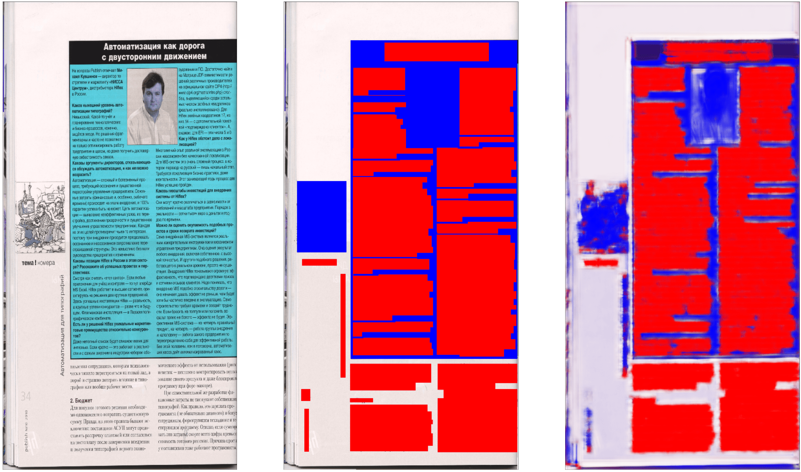
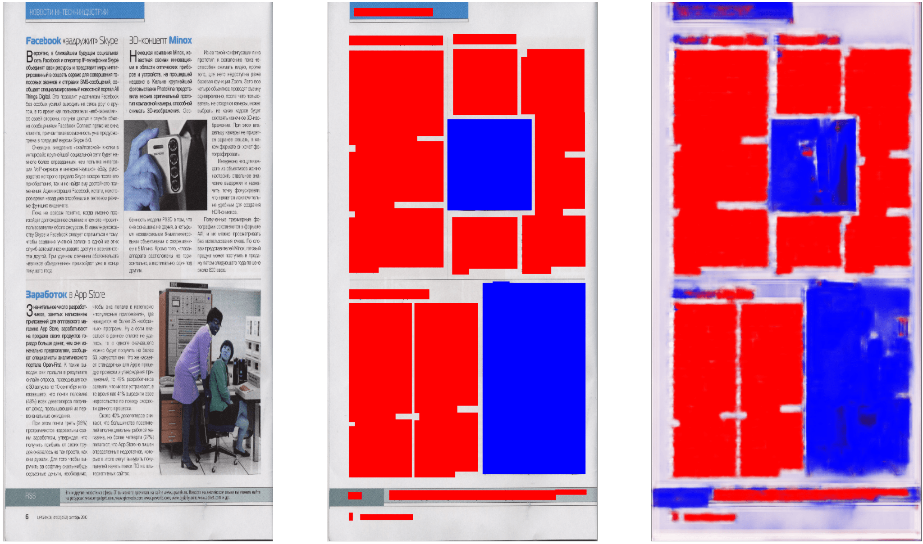
Newspaper segmentation model on a Russian newspaper dataset
Fig 4 : Original RGB image, Corresponding Masked image and Final Masked image output.

Slide 13
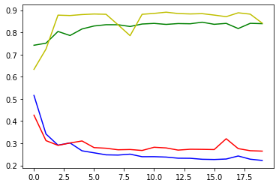
Newspaper segmentation model on a Russian newspaper dataset
noenwvlknevwnvlkene
Model Accuracy:-
Train Loss : 21.19 %
Train Accuracy : 84.93 %
Test Loss : 26.46 %
Test Accuracy : 84.14 %
Loss :- Blue color
Val_loss :- Red color
Accuracy :- Green color
Val_Accuracy :- Yellow color

Slide 14
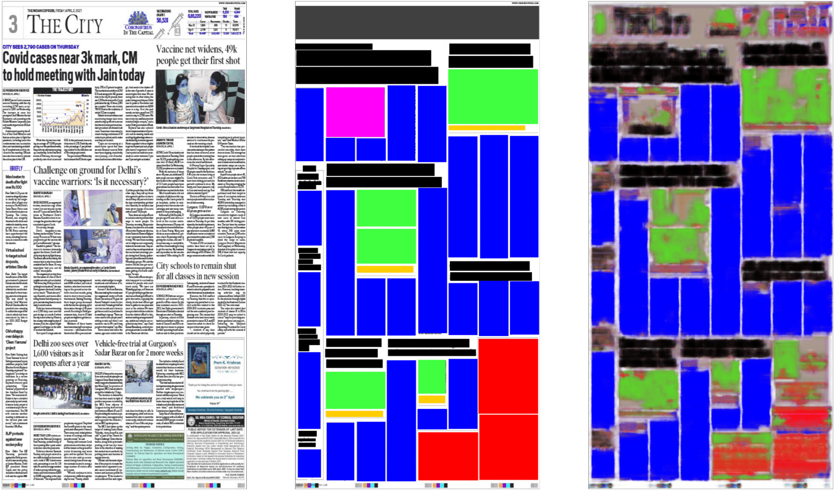
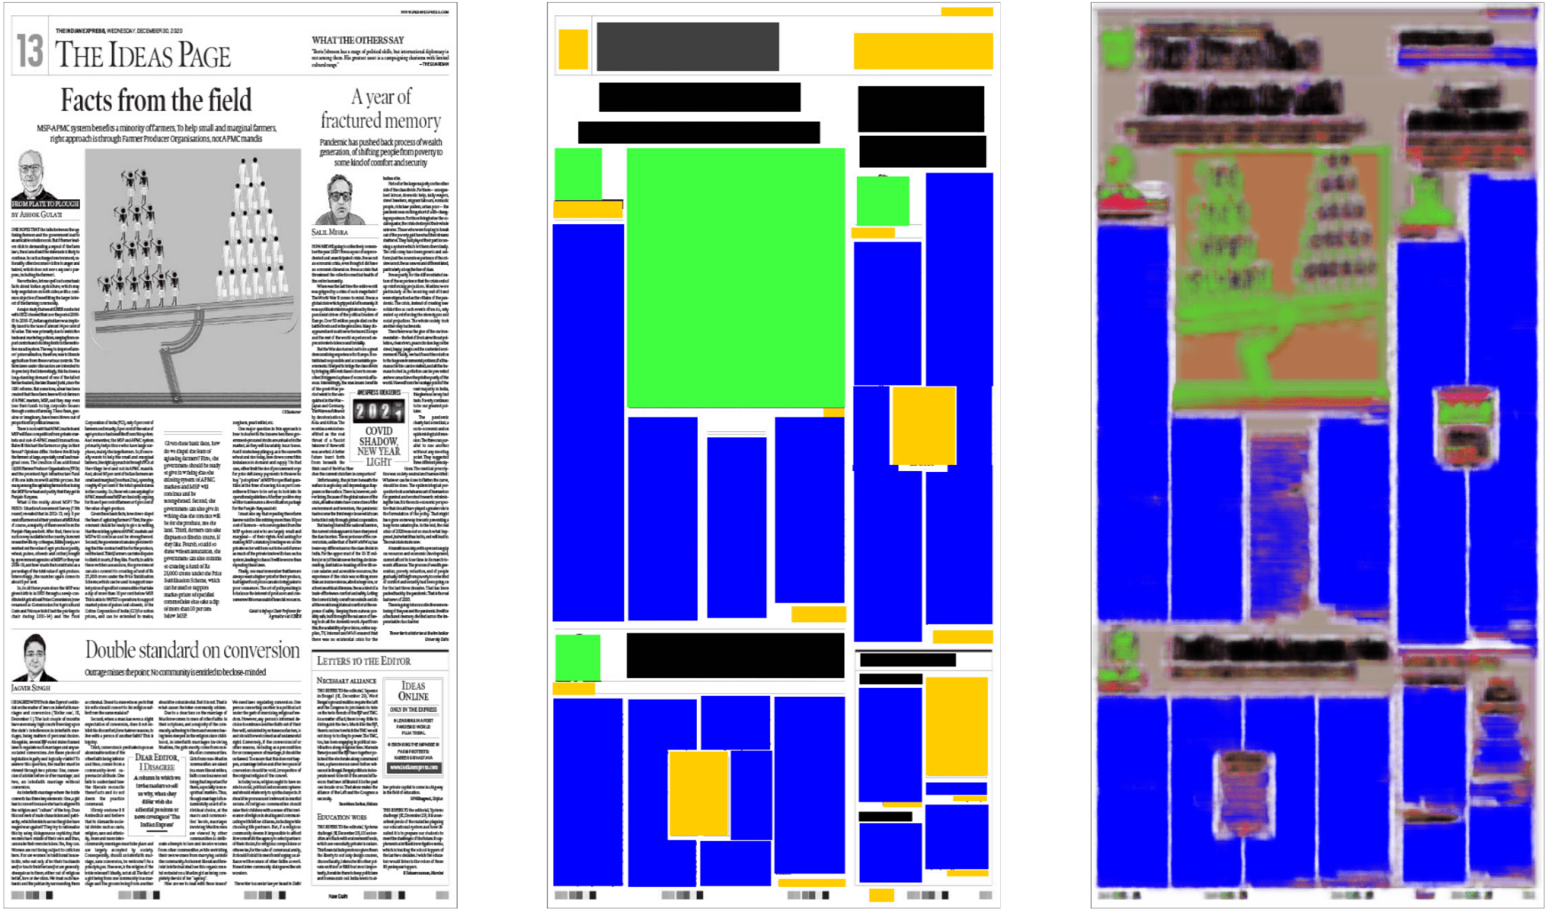
Newspaper segmentation model on a Manually Masked newspaper dataset with RGB input image.
Fig 5 : Original RGB image, Corresponding Masked image and Final Masked image output.

Slide 15
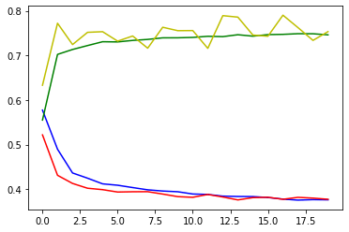
Newspaper segmentation model on a Manually Masked newspaper dataset with RGB input image.
noenwvlknevwnvlkene
Model Accuracy:-
Train Loss : 36.28 %
Train Accuracy : 78.25 %
Test Loss : 37.74 %
Test Accuracy : 75.32 %
Graph Representation
Loss :- Blue color
Val_loss :- Red color
Accuracy :- Green color
Val_Accuracy :- Yellow color

Slide 16
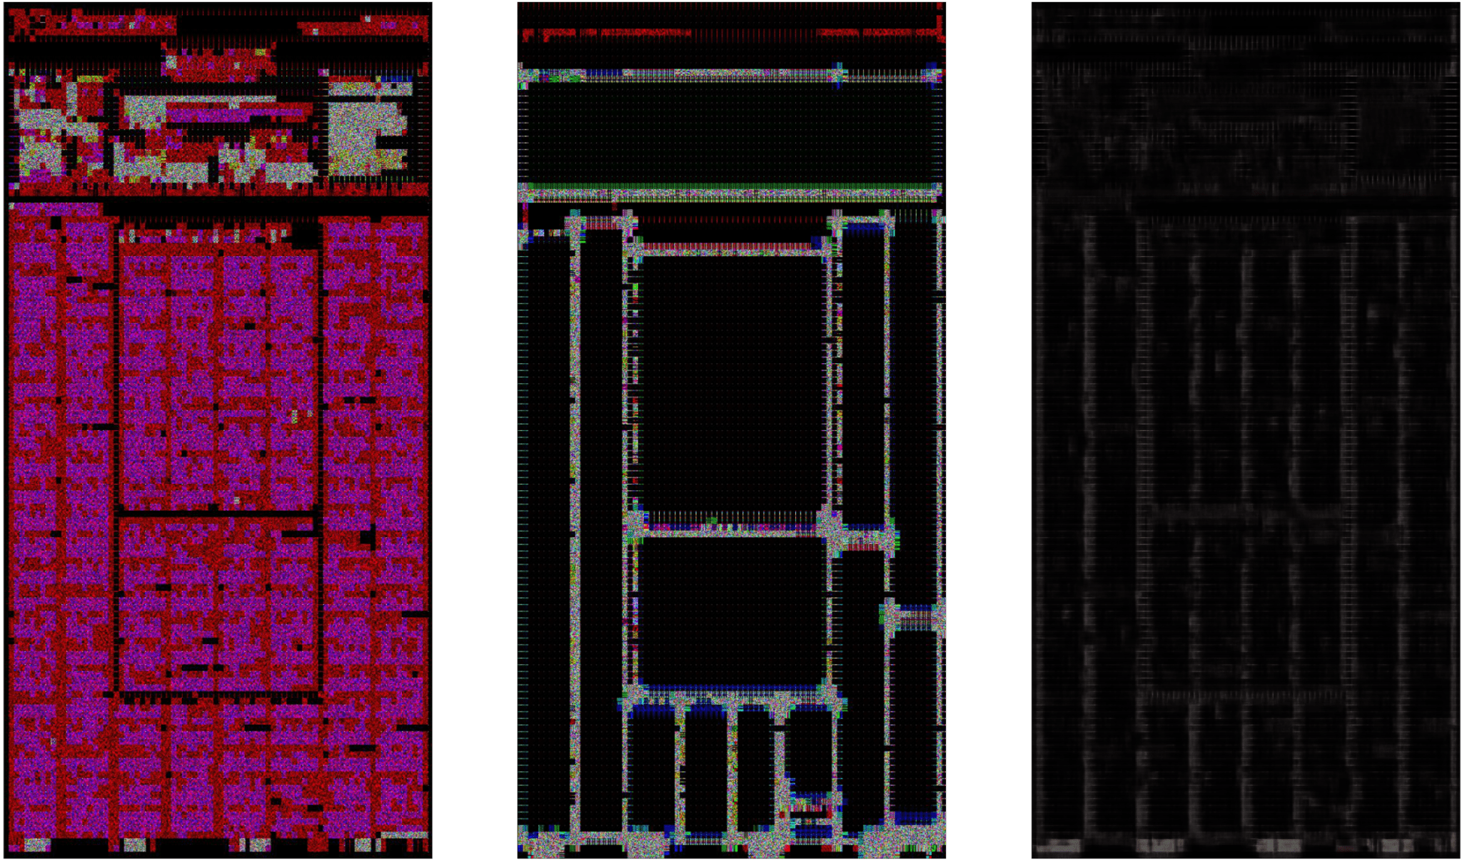
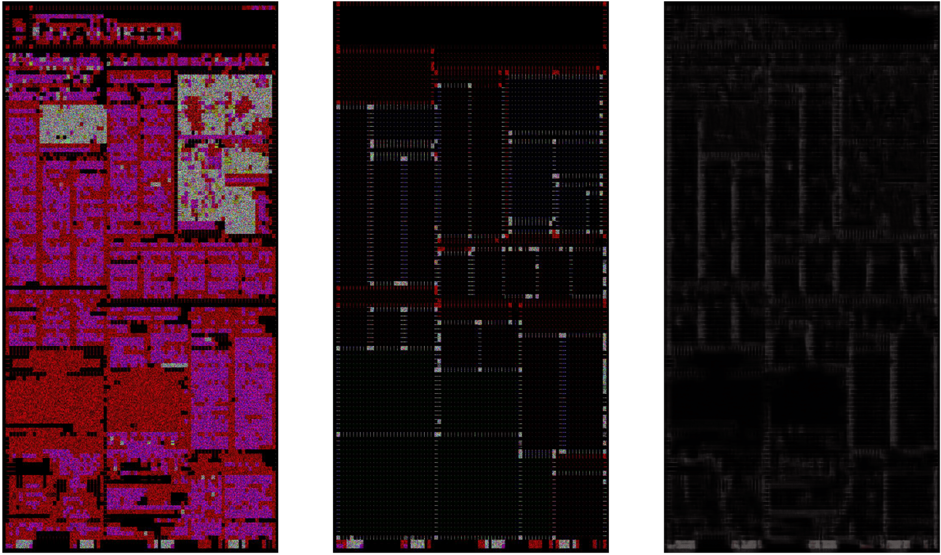
Newspaper segmentation model on a Manually Masked newspaper dataset with DCT input image.
Fig 6 : Original DCT image, Corresponding Masked image and Final Masked image output.

Slide 17
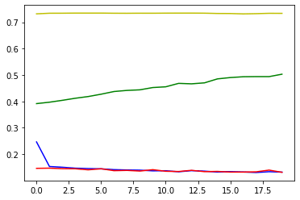
Newspaper segmentation model on a Manually Masked newspaper dataset with DCT input image.
noenwvlknevwnvlkene
Model Accuracy:-
Train Loss : 12.60 %
Train Accuracy : 73.12 %
Test Loss : 13.11 %
Test Accuracy : 73.38 %
Graph Representation
Loss :- Blue color
Val_loss :- Red color
Accuracy :- Green color
Val_Accuracy :- Yellow color

Slide 18
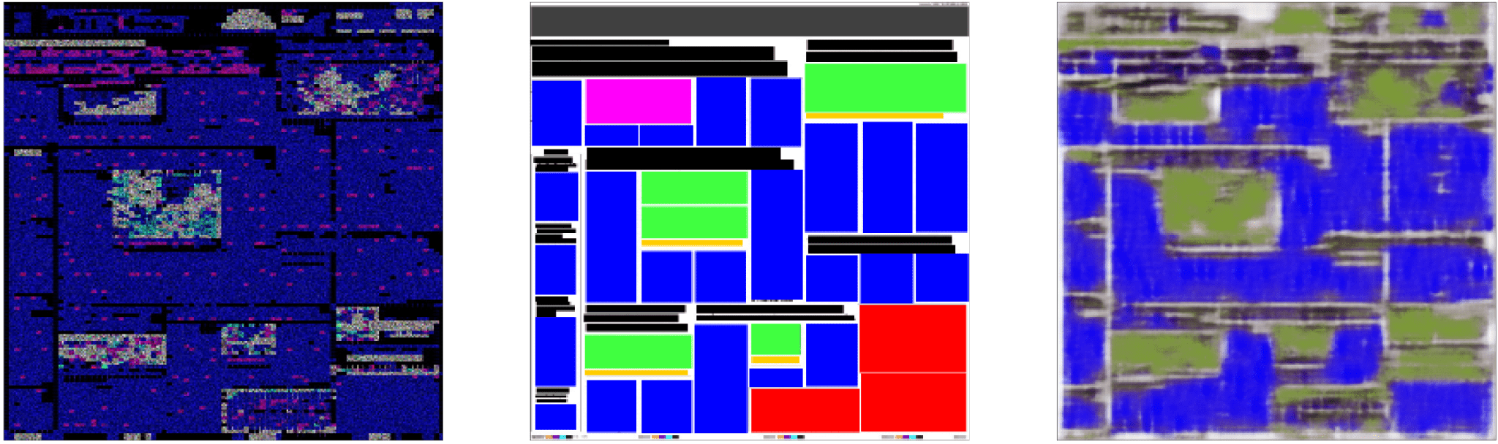
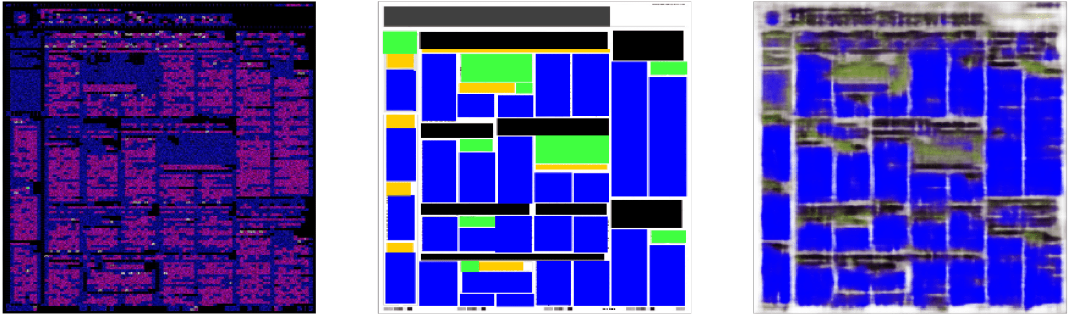
Newspaper segmentation model on a Manually Masked newspaper dataset with DCT image and RGB masked image.
Fig 6 : Original DCT image, Corresponding RGB Masked image and Final Masked image output.

Slide 19
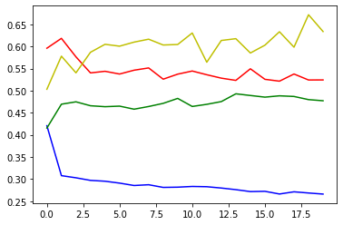
Newspaper segmentation model on a Manually Masked newspaper dataset with DCT image and RGB masked image.
noenwvlknevwnvlkene
Model Accuracy:-
Train Loss : 47.24 %
Train Accuracy : 66.44%
Test Loss : 52.42 %
Test Accuracy : 63.36 %
Graph Representation
Loss :- Blue color
Val_loss :- Red color
Accuracy :- Green color
Val_Accuracy :- Yellow color

Slide 20
Analysis on Loss and Accuracy over different color spaced input image
 | RGB | DCT | Mixed | Russian dataset
Train loss | 36.28 | 12.60 | 47.24 | 21.79
Train Accuracy | 78.25 | 73.12 | 66.44 | 90.59
Test loss | 37.74 | 13.11 | 52.42 | 27.41
Test Accuracy | 75.32 | 73.38 | 63.36 | 86.01
loss is the error evaluated during training / testing a model.
Accuracy is the measure of how accurate the model's prediction is compared to the true data.
The least train and test loss is from DCT input image in the model.
The highest train and test accuracy is from YCbCr input image in the model.
Table 1 : Score summary

Slide 21
Implementation Steps:
1) Importing Required libraries.( cv2, keras, numpy, pandas, matplotlib, sklearn, os )
2) Loading dataset.
3) Splitting dataset.
4) Model Preparation. {Convolutional layer, Max pooling and Up Sampling, Dropout}
5) Image Batch and Mask Batch.
6) CallBack functions Setup. { Model Checkpoints , EarlyStopping }
7) Model fitting. {Steps per epoch = 100, epoch = 20, verbose = 1 }
8) Predicting Output.
9) Calculating Loss and Accuracy.

Slide 22
THANK YOU

